Slide 1

Azure Essentials for .NET Developers This is not a sales pitch K. Scott Allen @OdeToCode
Notes:
Hi everyone, my name is Scott, and this talk is about the new dragons of JavaScript. This is not a negative talk where I bash JavaScript features. Instead, I’m trying to express my feelings as I’ve worked with the new language features for over a year now.

Slide 2
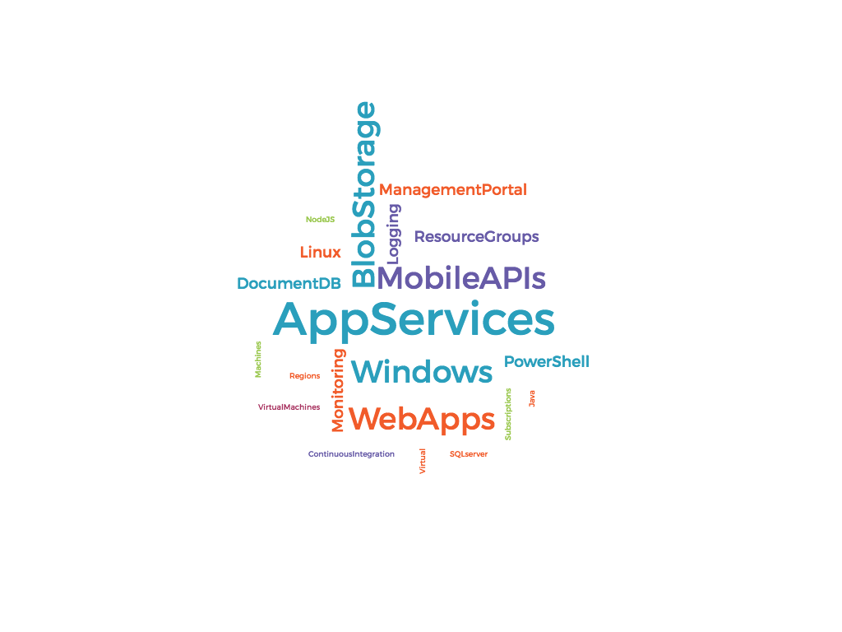
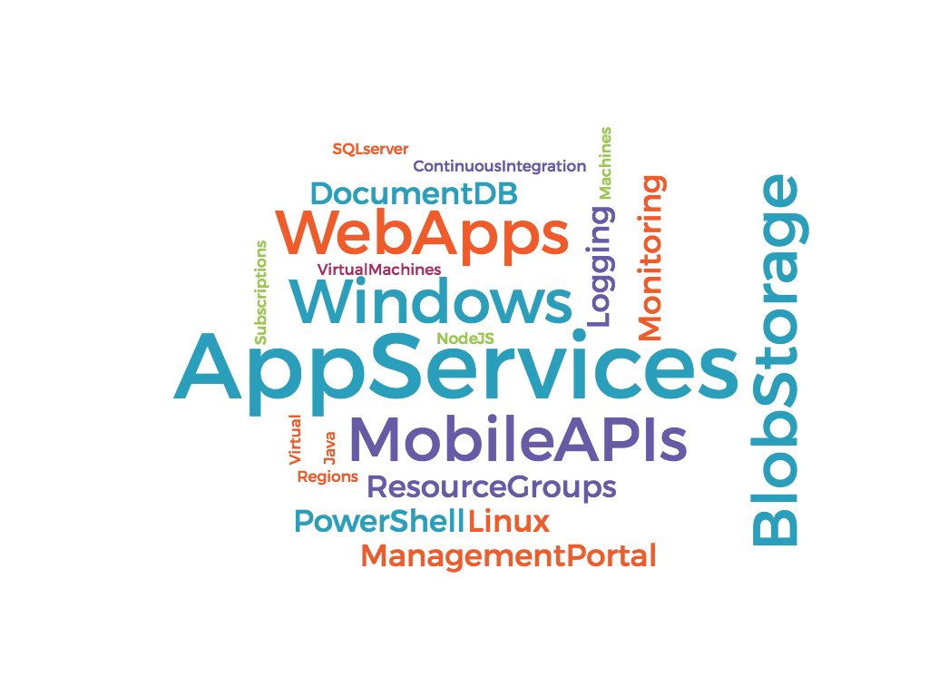
Notes:
Here I was thinking of having a large tag cloud with Azure related terms. Use this to introduce the basic idea of “what is azure” and how we will dispel lthe mumbo jumbo

Slide 3







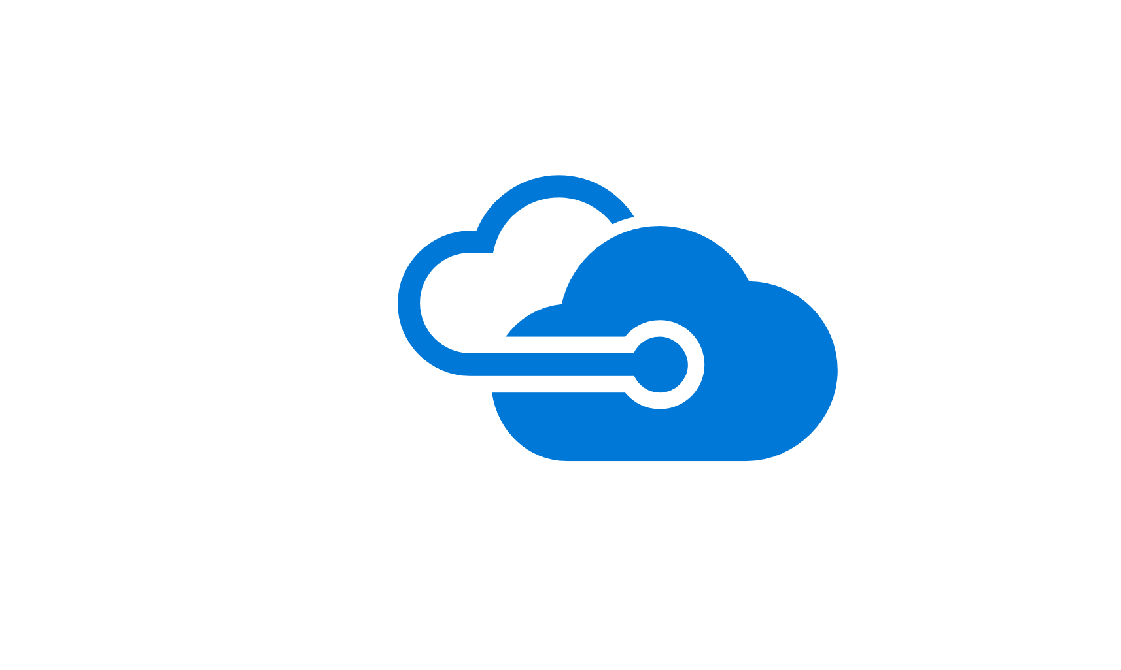




Virtual Machines
Cloud Databases & Storage
Microsoft
Azure
App Services &
Functions
Automation
Notes:
These are the azure resources we’ll be using in the course. In Azure itself there are 2 dozen more things we could use, but I think I just want to highlight the stuff we’ll see in the course. These should animate in clockwise

Slide 4

Microsoft
Azure
Notes:
The idea is to show the breadth of support Azure provides for different technologies.

Slide 5
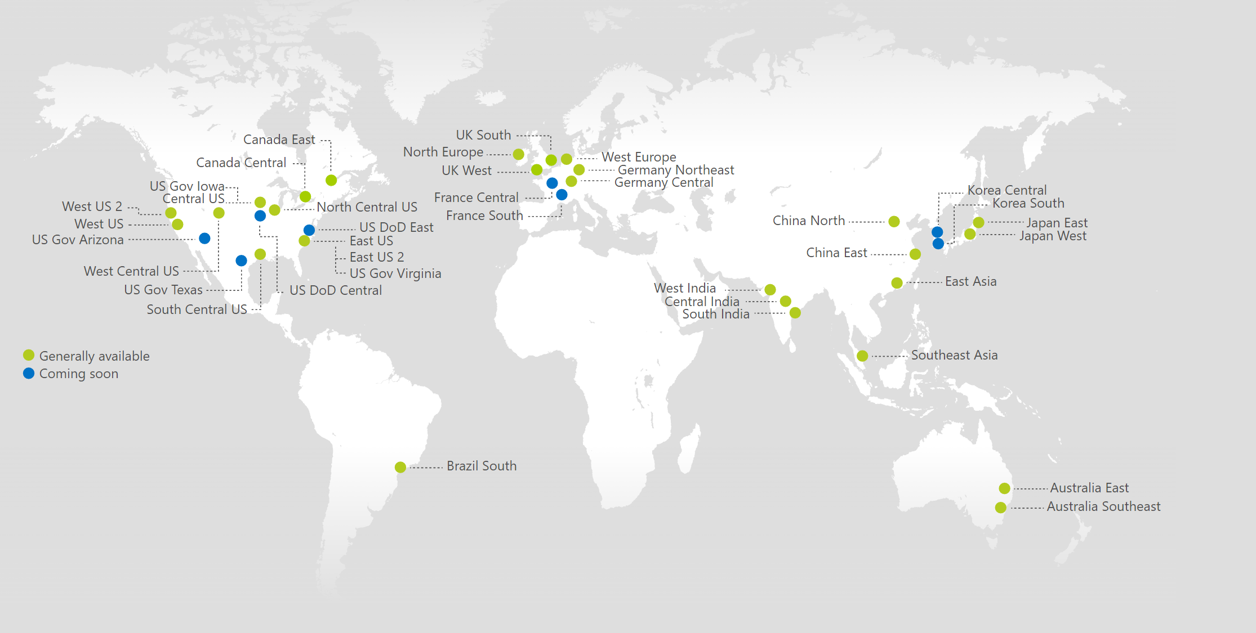
Azure Data Centers
https://azure.microsoft.com/en-us/regions/
Notes:
This map from the MSFT documentation shows the Azure data centers all across the world. The idea is to marvel in awe at the data centers around the world.

Slide 6
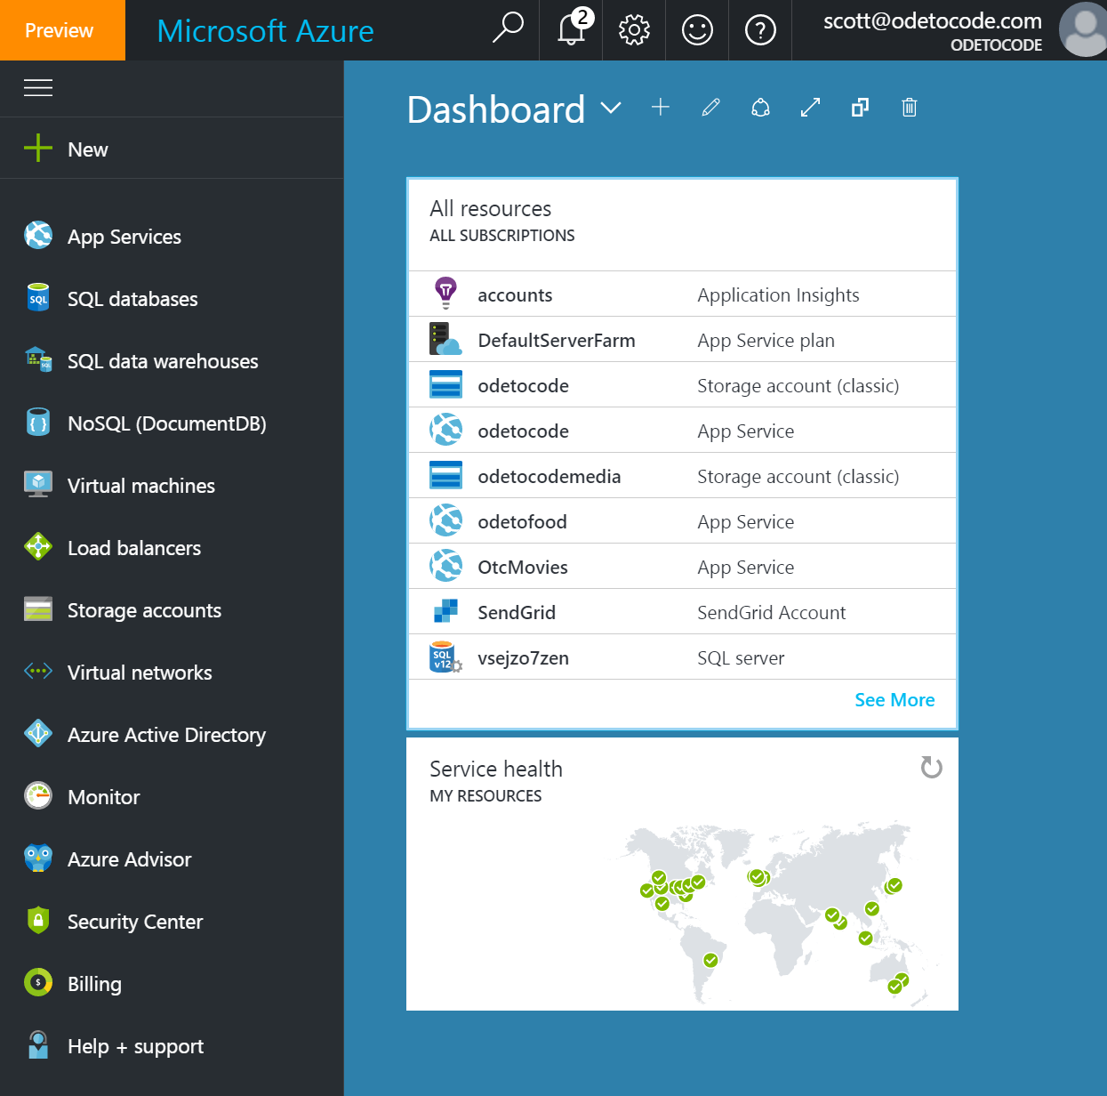
Web Portal
Notes:
There will be a couple different ways to create and manage a resource in azure, the web portal, or powershell. We’ll start with the portal.

Slide 7
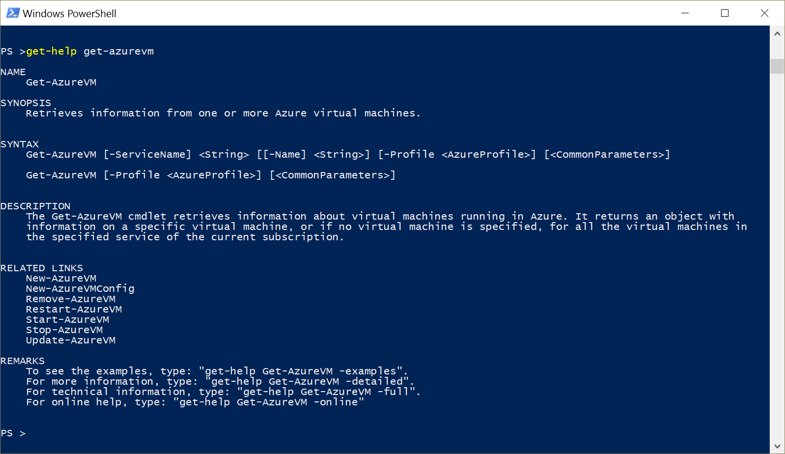
PowerShell
Notes:
There will be a couple different ways to create and manage a resource in azure, the web portal, or powershell. We’ll start with the portal.

Slide 8





Infrastructure as a Service (IaaS)
Platform as a Service (PaaS)
On Premises
Apps
OS
Apps
OS
Apps
OS
Hardware
Hardware
Hardware
You
Azure
Notes:
Showing what you manage versus what azure manages in each scenario. Want to animate in each scenario left to right

Slide 9




Web Applications
API Applications
Microsoft
Azure
App Services
Mobile Applications
Logic Applications
Notes:
Talk about what app services consists of. Animate in from top left clockwise

Slide 10
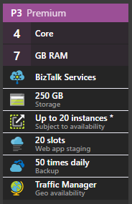
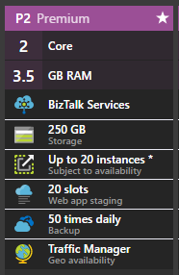

App
App
App Service Plan
App
Notes:
Need to demonstrate that each app gets its own app service
Multiple app services can share a single app plan
Every app plan can scale UP (to a bigger app plan) or OUT (to more instances)
Animations carefully orchestrated to show the concepts I talk about one at a time ☺

Slide 11
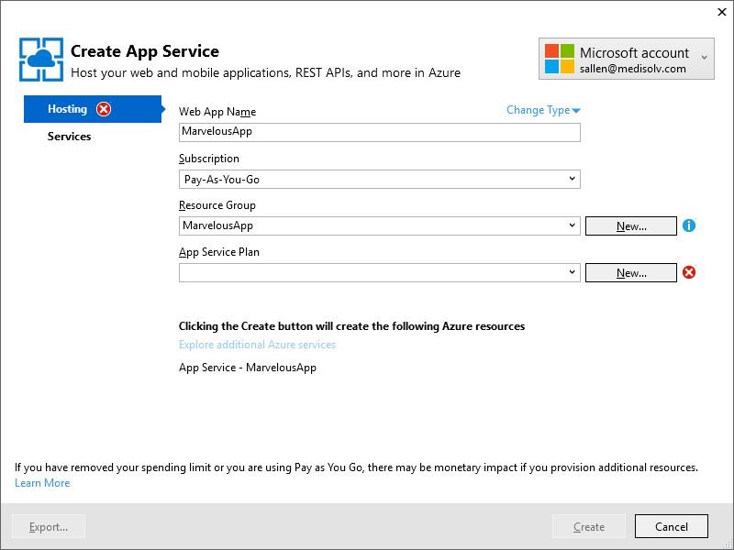

Notes:
At a loss here ☺
I’m going to talk about how I use Visual Studio (icon on the left) to create an app service (window clip in the middle) to put the app into the cloud (icon on the right)
Yes, the window is ugly, but just need something visual for a 30 second discussion

Slide 12
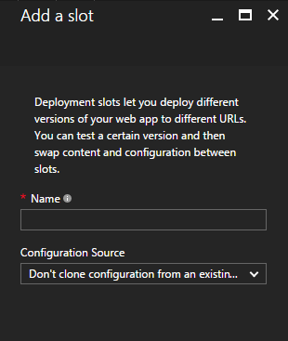
Notes:
When you deploy an application, you can setup deployment slots (first icon)
Add a slot to the app service (middle icon)
Right-hand side shows we could have 3 slots
Last animation of curved arrow to talk about how easy it is to swap slots

Slide 13
QA
Staging
Production
Notes:
When you deploy an application, you can setup deployment slots (first icon)
Add a slot to the app service (middle icon)
Right-hand side shows we could have 3 slots
Last animation of curved arrow to talk about how easy it is to swap slots

Slide 14
QA
Staging
Production
Notes:
When you deploy an application, you can setup deployment slots (first icon)
Add a slot to the app service (middle icon)
Right-hand side shows we could have 3 slots
Last animation of curved arrow to talk about how easy it is to swap slots

Slide 15
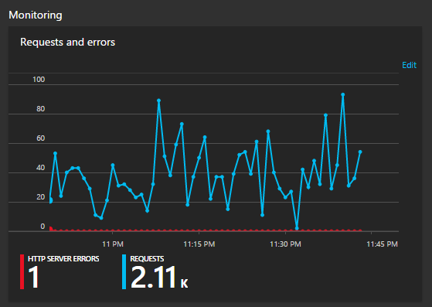
Monitoring
Notes:
For a 30 second into to monitoring

Slide 16
Monitoring
Notes:
For a 30 second into to monitoring

Slide 17
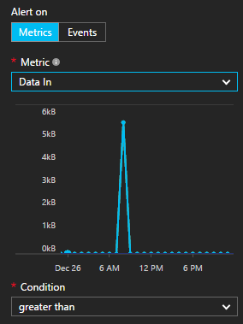

Email Alerts
Notes:
Need a visual to talk for 30 seconds about setting up alerts that can deliver email to me if something is going loopy

Slide 18
Email Alerts
Notes:
Need a visual to talk for 30 seconds about setting up alerts that can deliver email to me if something is going loopy

Slide 19
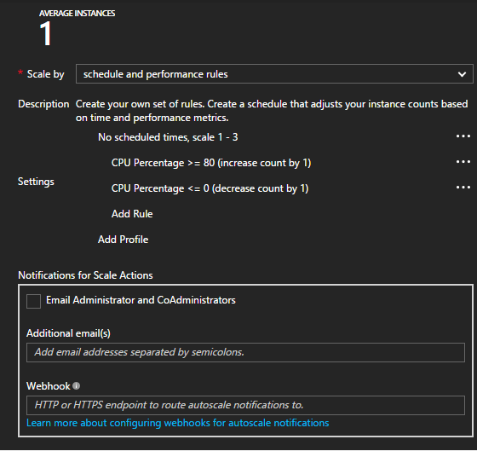
Scaling
Notes:
30 seconds of visual to talk about scaling in Azure. Can scale up an instance or down an instance when thresholds are exceeded

Slide 20
Scaling
Notes:
30 seconds of visual to talk about scaling in Azure. Can scale up an instance or down an instance when thresholds are exceeded

Slide 21
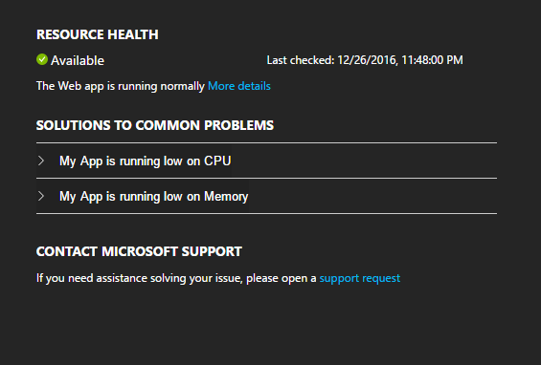
Debugging
Tools
Notes:
30 second visual to talk about troubleshotting, remote debugging, tools we can use to find out what is going on!

Slide 22
Debugging
Tools
Notes:
30 second visual to talk about troubleshotting, remote debugging, tools we can use to find out what is going on!

Slide 23
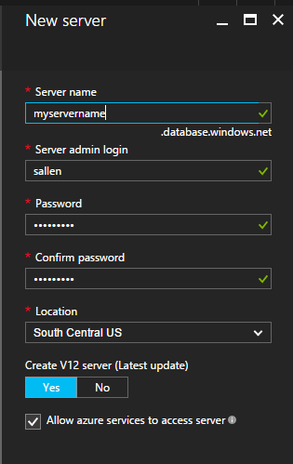


Server
Azure SQL Database
DocumentDB Database
Notes:
Two topics in this module – Azure SQL Databases and DocumentDB databases

Slide 24
Server
Notes:
Need to get across the point that a single Azure server can be a container for multiple databases instances

Slide 25
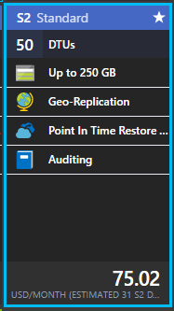
5
10
20
4000
Notes:
Explaining “data transfer units” – a measure of how much relative power you need from a database, ranges from 5 to 4000

Slide 26
50

Slide 27
50
2500

Slide 28
50
2500
4000

Slide 29
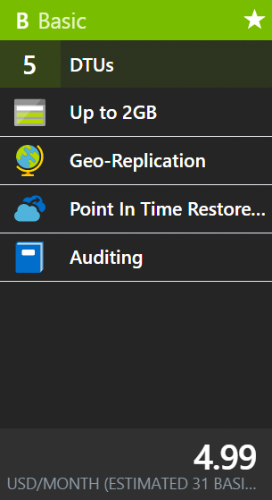
5

Slide 30
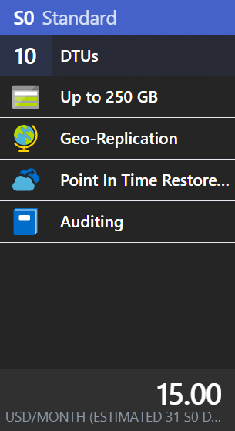
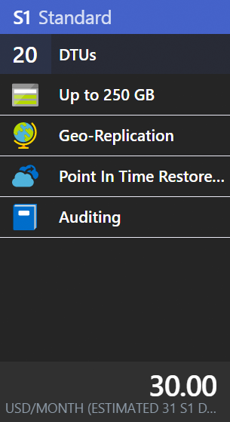
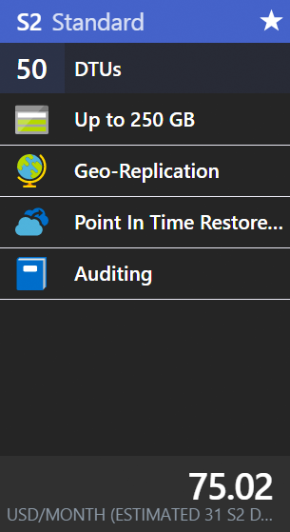
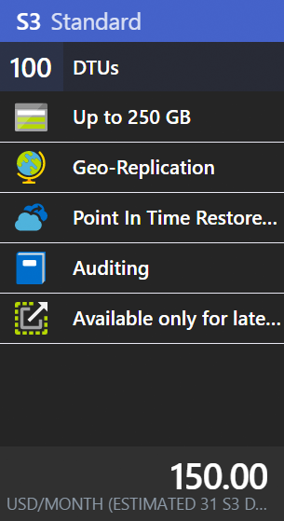
10-100

Slide 31
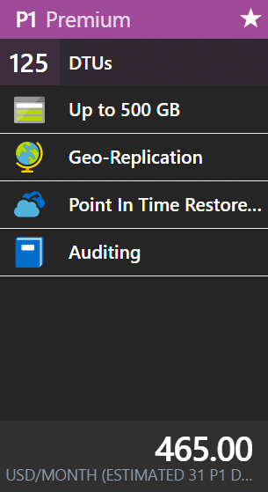
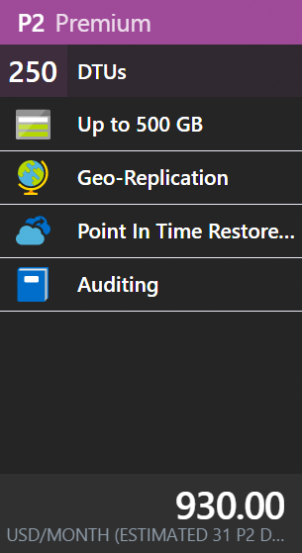
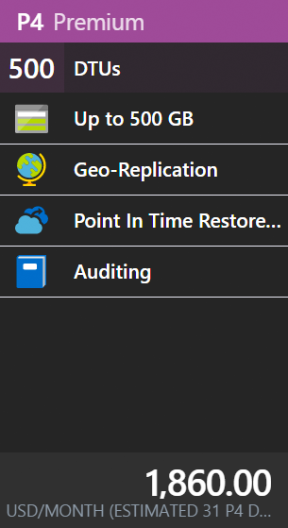
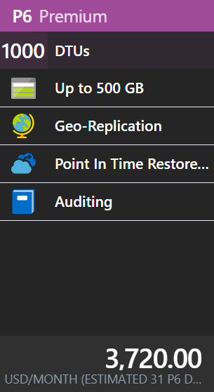
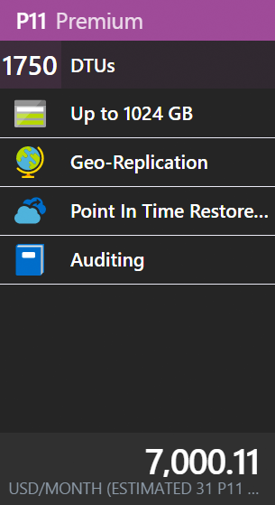
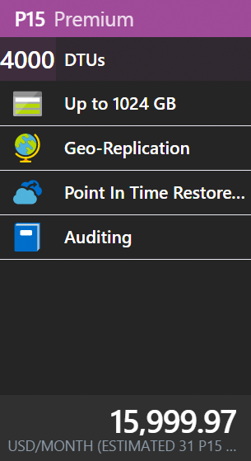
125 - 4000

Slide 32
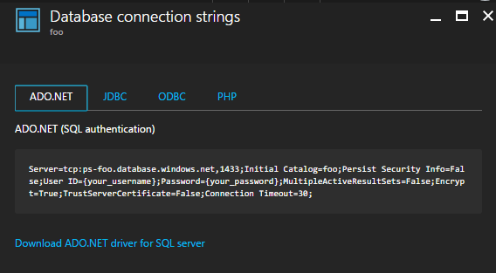
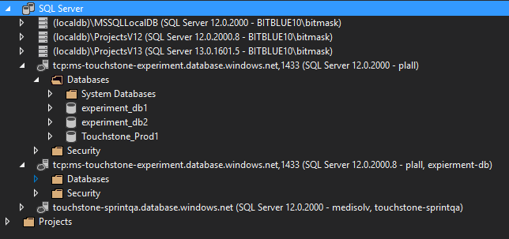
Notes:
With SQL Azure, you can connect using ADO.NET, etc. Any regular SQL Server tools will give you access to the database.

Slide 33
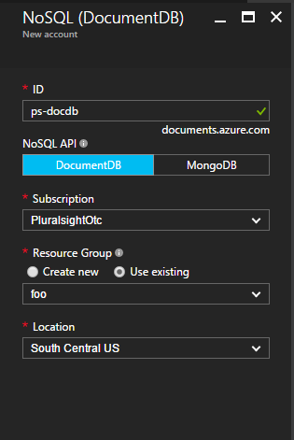
Notes:
Turning attention to DocumentDB

Slide 34



Blob Storage
Table Storage
Queue Storage
File Storage
Notes:
Types of Azure Storage. Want to highlight blob storage as that is primarily what we will focus on.

Slide 35
Blob Storage
Table Storage
Queue Storage
File Storage
Notes:
Types of Azure Storage. Want to highlight blob storage as that is primarily what we will focus on.

Slide 36
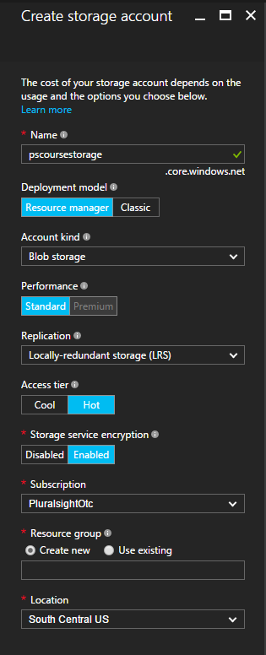
Account
Blobs
Containers
0001.tiff
scans
0002.tiff
0003.tiff
app01.xml
applicants
app02.xml
app03.xml
Notes:
First we create a storage account. Inside an account you can have multiple containers. Inside a container you can have multiple blobs.

Slide 37

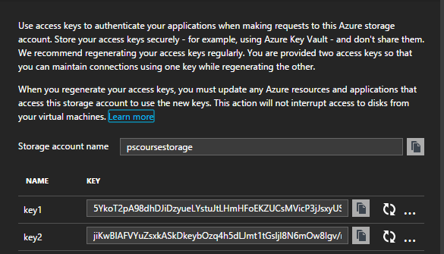
Access Keys
Notes:
To connect to storage, we need to use one of the ACCESS KEYS

Slide 38

Access Keys
Notes:
To connect to storage, we need to use one of the ACCESS KEYS

Slide 39
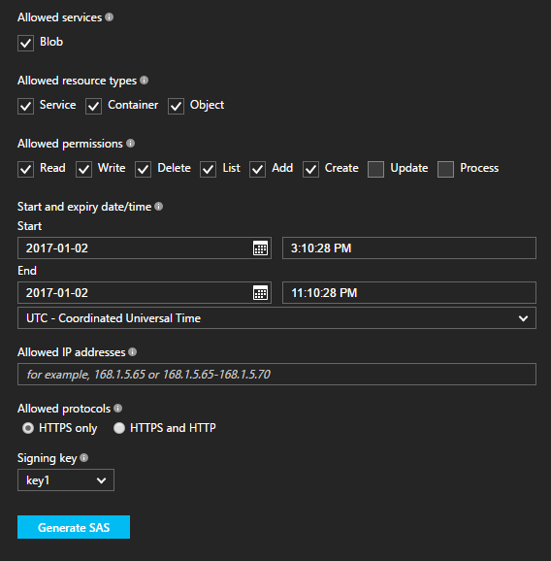

Shared Access Signatures
Notes:
SHARED ACCOUNT SIGNATURES allow us to delegate some rights to staorge

Slide 40

Shared Access Signatures
Notes:
SHARED ACCOUNT SIGNATURES allow us to delegate some rights to staorge

Slide 41
Execute small functions
Serverless Computing
C#, F#, Node, Ruby, PHP
Nanoservices
Pay only for execution time
Azure Functions
Triggers, webhooks, and timers
Notes:
Talking points.
Want to do serverless computing?
Here’s Azure Functions!
What they do, how to implement

Slide 42

Agile Tools
iOS
Git
Android™
Continuous Integration
Linux™
Testing
Windows®
Reporting
Notes:
Along the left – describing what we can build (projects for ios, android, linux, windows)
Along the right – describing services offered

Slide 43
Agile Tools
iOS
Git
Android™
Continuous Integration
Linux™
Testing
Windows®
Reporting
Notes:
Hightlight that we will be using Git and setting up CI in ths module

Slide 44
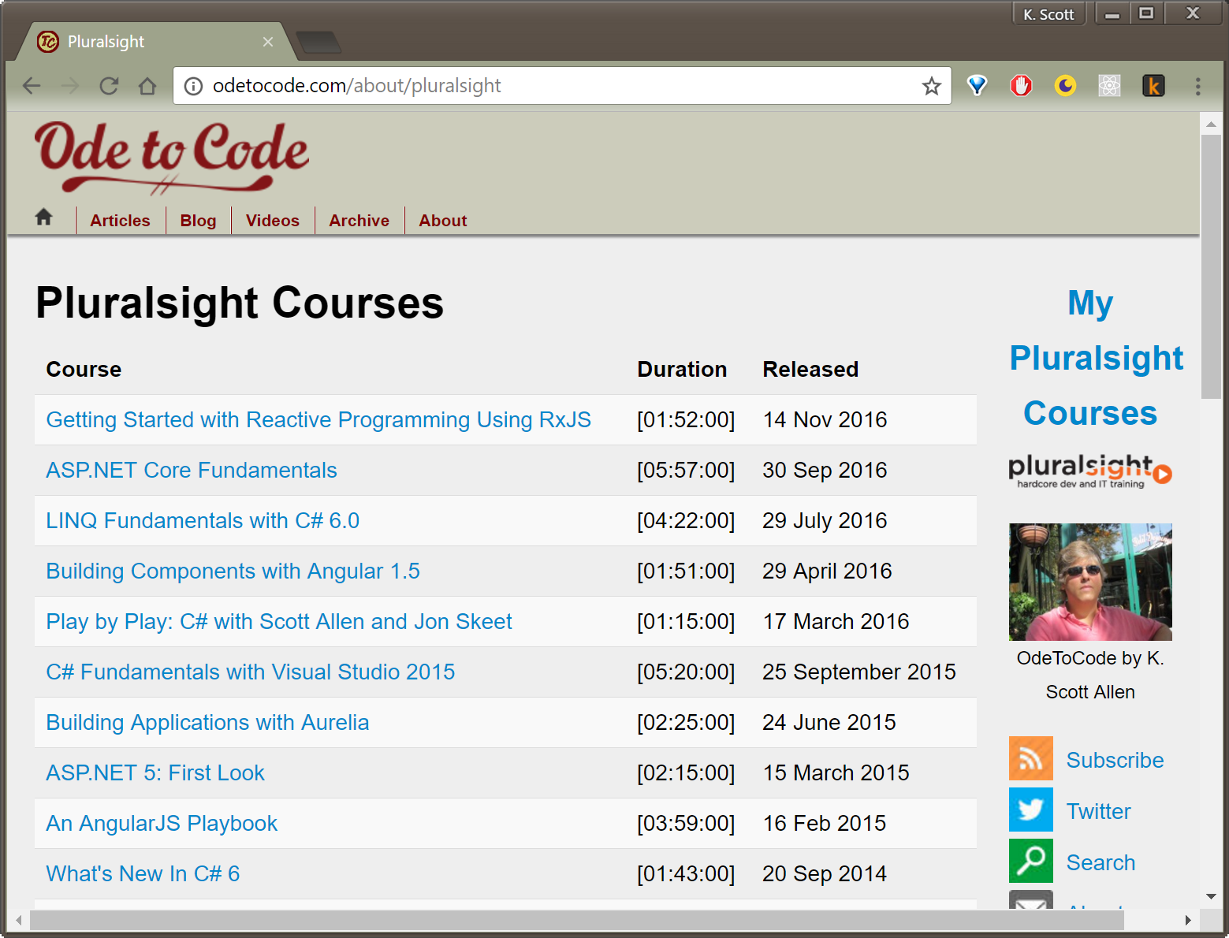
Thanks!
scott@OdeToCode.com

